Slide 1
Process Improvement Project Reducing Errors
Elia Kostyrka
MBC 638 Data Analysis & Decision Making, 2019-0109
Syracuse University

Slide 2

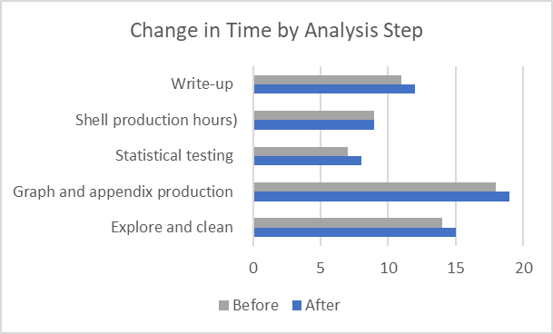
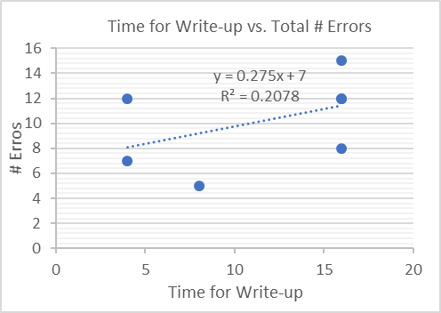
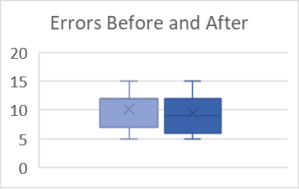
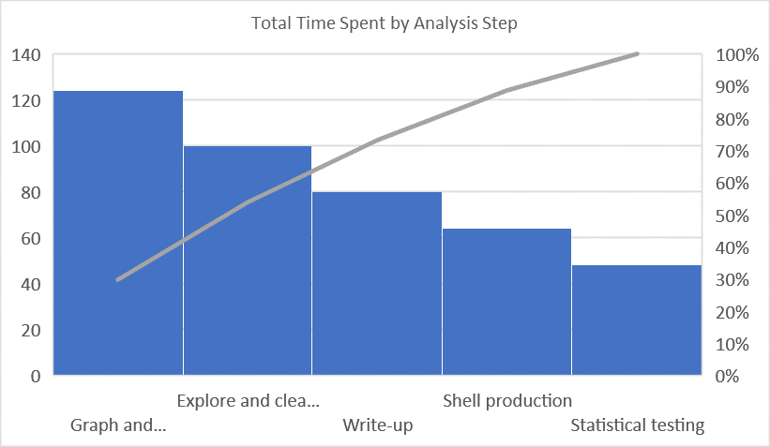
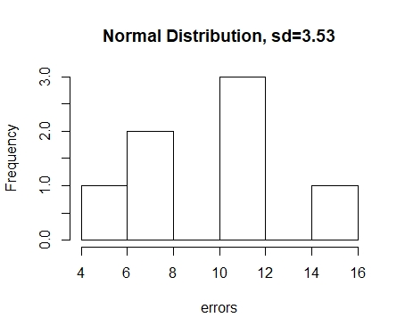
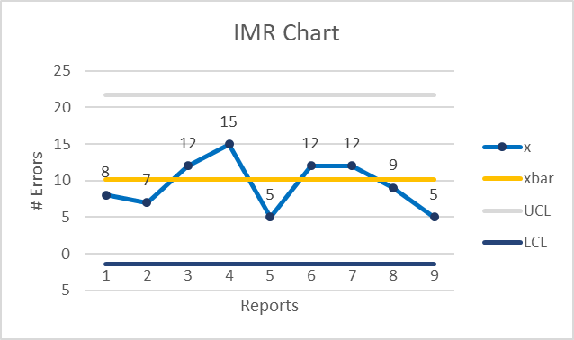
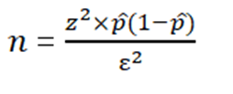
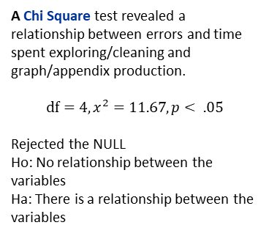
Reducing Errors
Process owner: Elia Kostyrka
Key Dates → | Define 01/09 | Measure 01/10-02/04 | Analyze 01/16-02/06 | Improve 1/24-03/08 | Control Ongoing
DEFINE
MEASURE
ANALYZE
IMPROVE
Problem: Time spent on different steps of data analysis varies in the production of bi-weekly reports. Not spending enough time in critical areas increases the risk for errors and the possibility for a rework if errors are not caught during the QA cycle.
Business Impact: A rework can cost a total of $2.5K per report ($59K in yr.)
Goal: Focus time on critical report production processes to reduce errors.
Data: Seven continuous reports from Oct ‘18 to Jan ‘19 were collected. Each report includes 25 sub-analyses. Data was compared between time spent on each analysis step and number of errors.
Operational Definitions
Output (y): An error, miscalculation of sub-analysis reflected in a report.
Input (x’s): Time spent on a step of the report production cycle, Exploring and Cleaning Data, Graph and Appendix Production, Shell Production, Statistical Testing, and Write-up.
A scatterplot showed a positive relationship between Errors and time spent on the Write-up; therefore, I could eliminate this area as a critical input to reduce errors.
Additional time was spent on critical steps in data analysis for the next two reports.
3
hrs
More time on critical input variables
A box and whisker plot shows that the average number of errors over all nine reports decreased from 10.14 to 9.44 per report.
Positive relationship
between Errors and time spent on the Write-up of the report
Focusing on critical steps can help reduce the number of errors
(risk for rework)
A pareto chart shows that Graph and Appendix production time was having the largest influence over the quality of the report, followed by time spent on exploring and cleaning data.
avg
errors
90% of report production time spent on Graph and Appendix production
0.1
SQL
The sigma quality level (SQL) improved from 1.7 to 1.8.
Correlation between
Errors and Explore/Clean and Graph/Appendix Production time
CONTROL
Errors vary widely from the mean
M = 10 errors, s = 3.53
There is a trend towards improvement in # errors
A Chi Square test revealed a relationship between errors and time spent exploring/cleaning and graph/appendix production.
$$df=4, x^{2}=11.67, p< .05$$
Rejected the NULL
Ho: No relationship between the variables
Ha: There is a relationship between the variables
A control chart comparing error results from the two last reports against the previous data shows improvement.
error
trend
Process far from six sigma quality level, but in line with where most companies operate
Met sample size for 95% confidence in data
Sample size formula shows that 119 samples, or 4 reports (25 sub-analysis per report) are needed to have 95% confidence in our data.
Defects/errors are inherent in the current report production process. The sigma quality level (SQL) for the initial seven reports was 1.7.
Notes:
Goals: The goal is to improve the efficiency of data cleaning and analysis of bi-weekly reports by 50% (from 4-5 days to 2-3 days), therefore increasing the amount of time spent on the write-up and review to eliminate the need for a report rework and save the customer money.

Slide 3
DEFINE Problem Statement and Impact
Reducing Errors
Process owner: Elia Kostyrka
Purpose: The purpose of this process improvement project is to reduce the number of errors in our training evaluation reports.
Problem: Time spent on different steps of data analysis varies in the production of bi-weekly reports. Not spending enough time in critical areas increases the risk for errors and the possibility for a rework if errors are not caught during the QA cycle.
Business Impact: A rework can cost a total of $2.5K per report ($59K in 12-months)
Goal: Focus time on critical report production processes to reduce errors.
Success is defined as showing a decrease in the number of errors from the current average of errors.
Input Variable: Includes time spent on each step of the report development phase, transformed into hours (estimated from number of days spent on each step).
Exploring and cleaning data
Production of graphs and appendices
Development of the initial shell of the report
Statistical testing
Report write-up
Output variable: Includes the number of errors (miscalculations) of sub-analysis reflected in the report and caught during the quality assurance (QA) review cycle. There are 25 sub-analyses required throughout the report.
Process owner: Myself, as the team lead of the project I delegate tasks and set timelines.
Notes:
Goals: The goal is to improve the efficiency of data cleaning and analysis of bi-weekly reports by 50% (from 4-5 days to 2-3 days), therefore increasing the amount of time spent on the write-up and review to eliminate the need for a report rework and save the customer money.

Slide 4
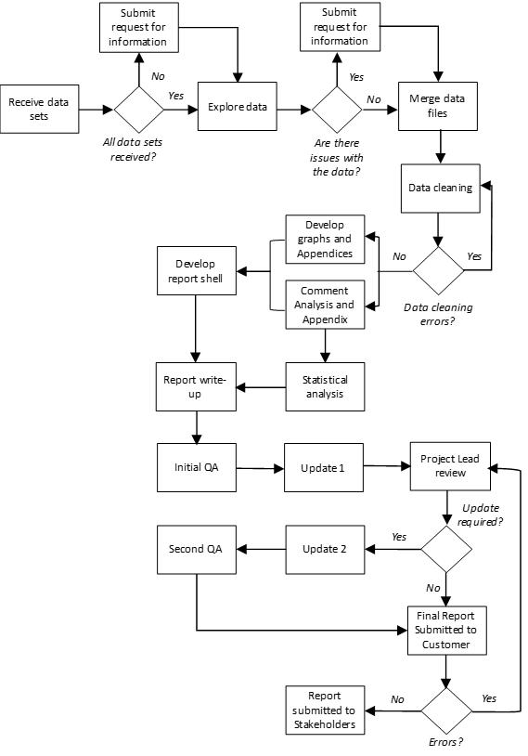
DEFINE Process Map
Reducing Errors
Process owner: Elia Kostyrka
Goal: Focus time on critical report production processes to reduce errors.
Exploring and cleaning data
Production of graphs and appendices
Development of the initial shell of the report
Statistical testing
Report write-up
Steps in Report Development
Errors caught during the QA cycle
Notes:
Goals: The goal is to improve the efficiency of data cleaning and analysis of bi-weekly reports by 50% (from 4-5 days to 2-3 days), therefore increasing the amount of time spent on the write-up and review to eliminate the need for a report rework and save the customer money.

Slide 5
DEFINE Operational Definitions
Reducing Errors
Process owner: Elia Kostyrka
Output (y): An error is a miscalculation of sub-analysis reflected in a report. There are a total of 25 sub-analyses conducted per report for a total of 175 possible miscalculations from the data collected over 7 reports.
Input (x’s): Time spent on a step of the report production cycle. Time spent was estimated as hours to complete each step. Typically a report is due 10 days after data is received. A weekly update shows when data is received from the customer and when a report is submitted. The remaining time was logged using various methods for each phase as listed below:
Exploring and Cleaning Data: Time spent reviewing data for errors and transforming data to be used for analysis.
Time stamps between the time the data was received and products were posted was logged.
Graph and Appendix Production: Time spent conducting analysis and developing data visualizations and associated appendices.
Time stamps on when data visualizations and appendices were uploaded to the SharePoint site were logged.
Shell Production: Time spent developing the format of the report and adding the completed data visualizations and appendices.
Time stamps between when products were posted and when the initial shell was e-mailed was logged.
Statistical Testing: Time spent conducting correlation analysis to determine relationships between scores and categorical groups.
Time stamps between when the shell was received via e-mailed, footnotes with statistical testing results was completed, and shell version 2 was e-mailed back was logged.
Write-up: Time spent interpreting the data analysis and statistical results and writing a narrative for the intended audience.
Time stamp between when the shell version 2 was posted and the initial report was e-mailed for the first QA review was logged.
Notes:
Goals: The goal is to improve the efficiency of data cleaning and analysis of bi-weekly reports by 50% (from 4-5 days to 2-3 days), therefore increasing the amount of time spent on the write-up and review to eliminate the need for a report rework and save the customer money.

Slide 6
DEFINE Normal Distribution
Reducing Errors
Process owner: Elia Kostyrka
Errors: A histogram showed that errors varied widely from the mean across all reports; therefore, there appeared to be no consistency in the processes followed in the development of reports to help reduce risk.
Notes:
Goals: The goal is to improve the efficiency of data cleaning and analysis of bi-weekly reports by 50% (from 4-5 days to 2-3 days), therefore increasing the amount of time spent on the write-up and review to eliminate the need for a report rework and save the customer money.

Slide 7
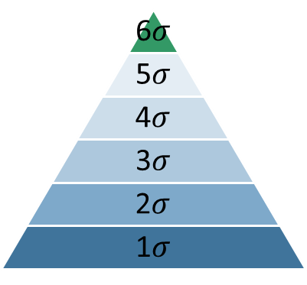
DEFINE Sigma Quality Level (SQL)
Reducing Errors
Process owner: Elia Kostyrka
There was a sigma quality level (SQL) value of 1.7 before improvement. The SQL level was in line with the level at which most companies operate, but still well below the ideal six-sigma quality level.
Before
1.7
Notes:
Goals: The goal is to improve the efficiency of data cleaning and analysis of bi-weekly reports by 50% (from 4-5 days to 2-3 days), therefore increasing the amount of time spent on the write-up and review to eliminate the need for a report rework and save the customer money.

Slide 8
MEASURE Data Measurement Plan
Reducing Errors
Process owner: Elia Kostyrka
Data collected included the number of errors and production time for steps in the analysis process.
Time was converted to hours and is considered continuous data.
Errors are considered discrete data.
Created a log with existing data.
Collected FY19 data to provide a good baseline to compare FY20 data.
Measurement error could exist in the calculations of errors per analysis based on QA feedback. In the future this error can be minimized by having QA note if it is a data calculation error.
Data Measurement Plan
Performance Measure | Data Source and Location | How Will Data Be Collected | Who will Collect Data | When will Data be Collected | Target Sample Size
# Errors | Reports with feedback from QA1 and QA2 | Access archived files, log number of errors per analysis section, log | Self | 01/09 | FY19 reports (7 each with 25 sub-analysis sections) 2 additional reports after improvement
# Possible data calculation errors | Data analysis checklist (25 separate analysis) | Obtain list from standard operating procedure and summarize each calculation needed, log | Self | 01/10 | Errors for 25 sub-analyses for 7 reports and 2 added reports for the improve and control phases
Time spent on each analysis step | SharePoint with posted analysis products and data stamp QA emails with data stamps Schedule with dates data was received and also report submission date | Include all variables from data analysis checklist and estimate time (days converted to hours) based on time stamps, log | Self | 01/10-02/01 | Data for 18 variables
Notes:
Goals: The goal is to improve the efficiency of data cleaning and analysis of bi-weekly reports by 50% (from 4-5 days to 2-3 days), therefore increasing the amount of time spent on the write-up and review to eliminate the need for a report rework and save the customer money.

Slide 9

MEASURE Sample Size Formula, Pareto Chart
Reducing Errors
Process owner: Elia Kostyrka
The sample size formula for discrete data was used to determine if the sample size was large enough to have 95% confidence in the data. Again, there are 25 sub-analysis conducted per report for a total of 175 possible calculation errors. The sample size met the requirement to have 95% confidence that the sample is representative of the population.
A pareto chart was used to identify which area could be having the most influence on the number of errors in the reports. 90% of the report production time was spent on the production of graphs and appendices, followed by exploring and cleaning the data.
$=\frac{\left(1.96\right)x0.4057\left(1−0.4057\right)}{0.0075}=119$ samples (4 reports)

Slide 10
ANALYZE Types of Tools
Reducing Errors
Process owner: Elia Kostyrka
Various tools were used to measure and analyze the data:
Sigma Quality Level (SQL)
Histogram
Pareto Chart
Scatterplot
Chi Square
A Pareto Chart showed that most of the report production time was spent developing the graphs and appendices for the reports.
A scatterplot showed a positive trend between errors and the time spent on a write-up so this variable was eliminated a critical input to reduce errors.
A Chi Square test showed that there was a significant relationship between errors and time to explore/clean data and product the graphs/appendices so these areas were identified as critical inputs to reduce errors.
Notes:
Goals: The goal is to improve the efficiency of data cleaning and analysis of bi-weekly reports by 50% (from 4-5 days to 2-3 days), therefore increasing the amount of time spent on the write-up and review to eliminate the need for a report rework and save the customer money.

Slide 11
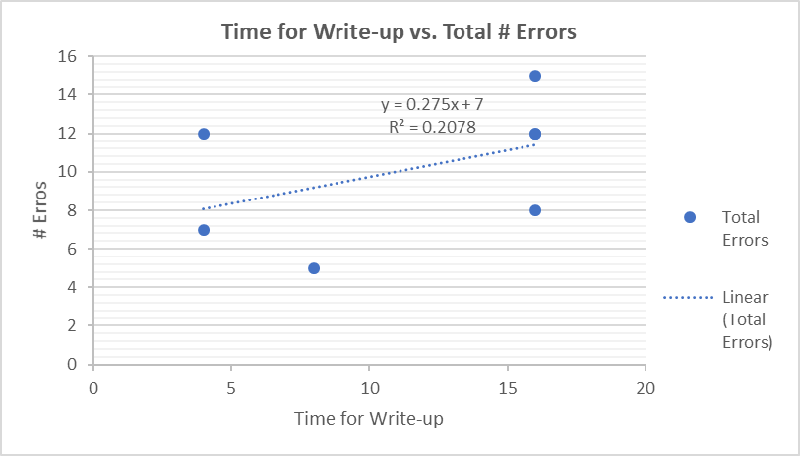
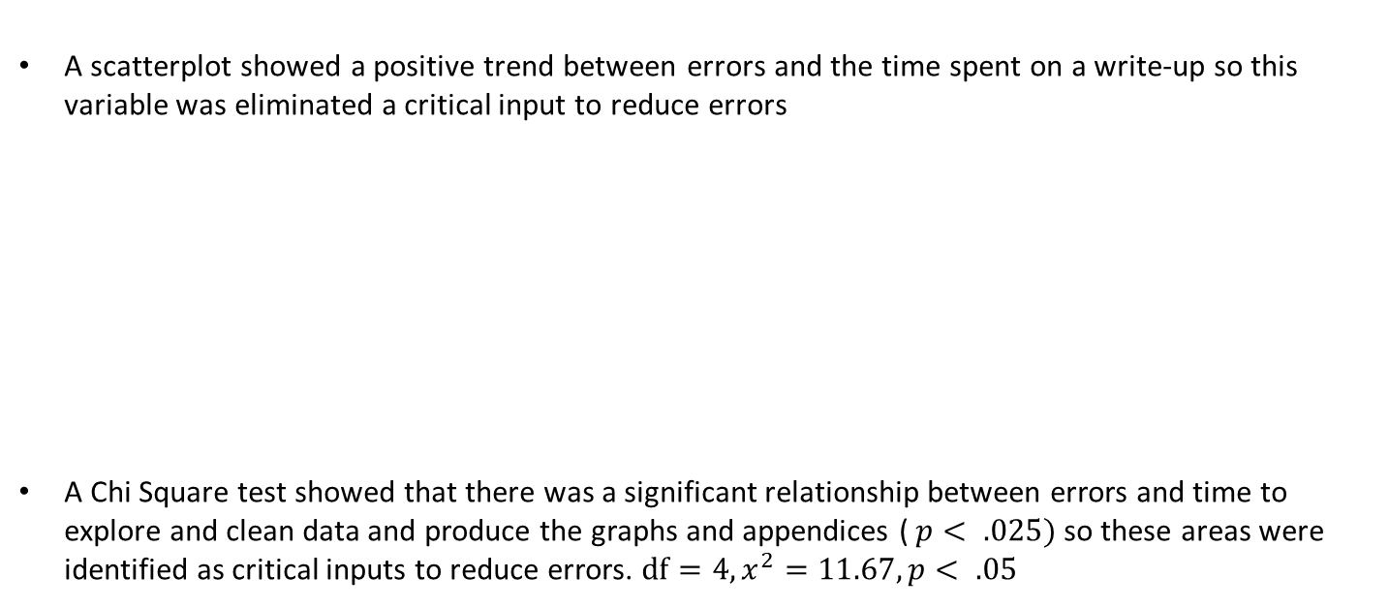
ANALYZE Scatterplot, Regression, Chi Square
Reducing Errors
Process owner: Elia Kostyrka
A scatterplot showed a positive trend between errors and the time spent on a write-up so this variable was eliminated a critical input to reduce errors
A Chi Square test showed that there was a significant relationship between errors and time to explore and clean data and produce the graphs and appendices ($p< .025)$so these areas were identified as critical inputs to reduce errors. $df=4, x^{2}=11.67, p< .05$

Slide 12
IMPROVE Types of Tools
Reducing Errors
Process owner: Elia Kostyrka
Various tools were used to during the improve and control phases:
Bar Chart
Box and Whisker Chart
Sigma Quality Level (SQL)
IMR Control Chart
A bar chart shows the increase in hours spent on critical input variables, exploring and cleaning data, graph and appendix production.
A box and whisker chart showing quartile distribution showed a decrease in the average number of errors over all reports.
A comparison of SQL before and after process improvement measures showed an increase in SQL level by 0.1.
The IMR control chart showed a trend towards improvement of number of errors after the last two reports.
Notes:
Goals: The goal is to improve the efficiency of data cleaning and analysis of bi-weekly reports by 50% (from 4-5 days to 2-3 days), therefore increasing the amount of time spent on the write-up and review to eliminate the need for a report rework and save the customer money.

Slide 13
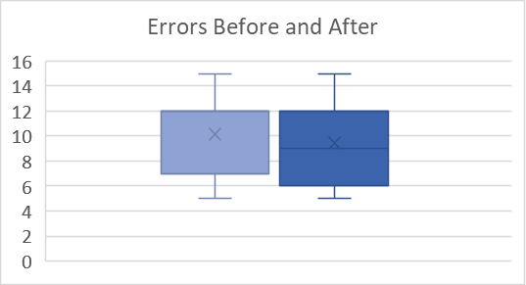
IMPROVE Process Improvement, Bar Chart, Box and Whisker Plot
Reducing Errors
Process owner: Elia Kostyrka
A bar chart shows the increase in hours spent on critical input variables. During the next two reports, there was a 3 hour average increase in time spent exploring and cleaning data, conducting graph and appendix production, and statistical testing versus with the write-up.
A box and whisker plot shows that the increase on critical input variables had an effect on the overall average mean of errors where the number of errors decreased from 10 to 9 on average.
Notes:
Goals: The goal is to improve the efficiency of data cleaning and analysis of bi-weekly reports by 50% (from 4-5 days to 2-3 days), therefore increasing the amount of time spent on the write-up and review to eliminate the need for a report rework and save the customer money.

Slide 14
CONTROL Sigma Quality Level (SQL), IMR Control Chart, Next Steps
Reducing Errors
Process owner: Elia Kostyrka
The SQL improved after process improvement to a level of 1.8.
The IMR control chart was helpful in identifying a trend towards improvement for the last two reports analyzed.
Next Steps: Continue the process of spending more time on critical input variables in the report production process (2-3 days each exploring/cleaning data and the production of graphs/ appendices) and utilize the control chart to plot the number of errors for future reports to help identify any negative trends.
Before
After
1.7
1.8
Notes:
Goals: The goal is to improve the efficiency of data cleaning and analysis of bi-weekly reports by 50% (from 4-5 days to 2-3 days), therefore increasing the amount of time spent on the write-up and review to eliminate the need for a report rework and save the customer money.

